Slide 1
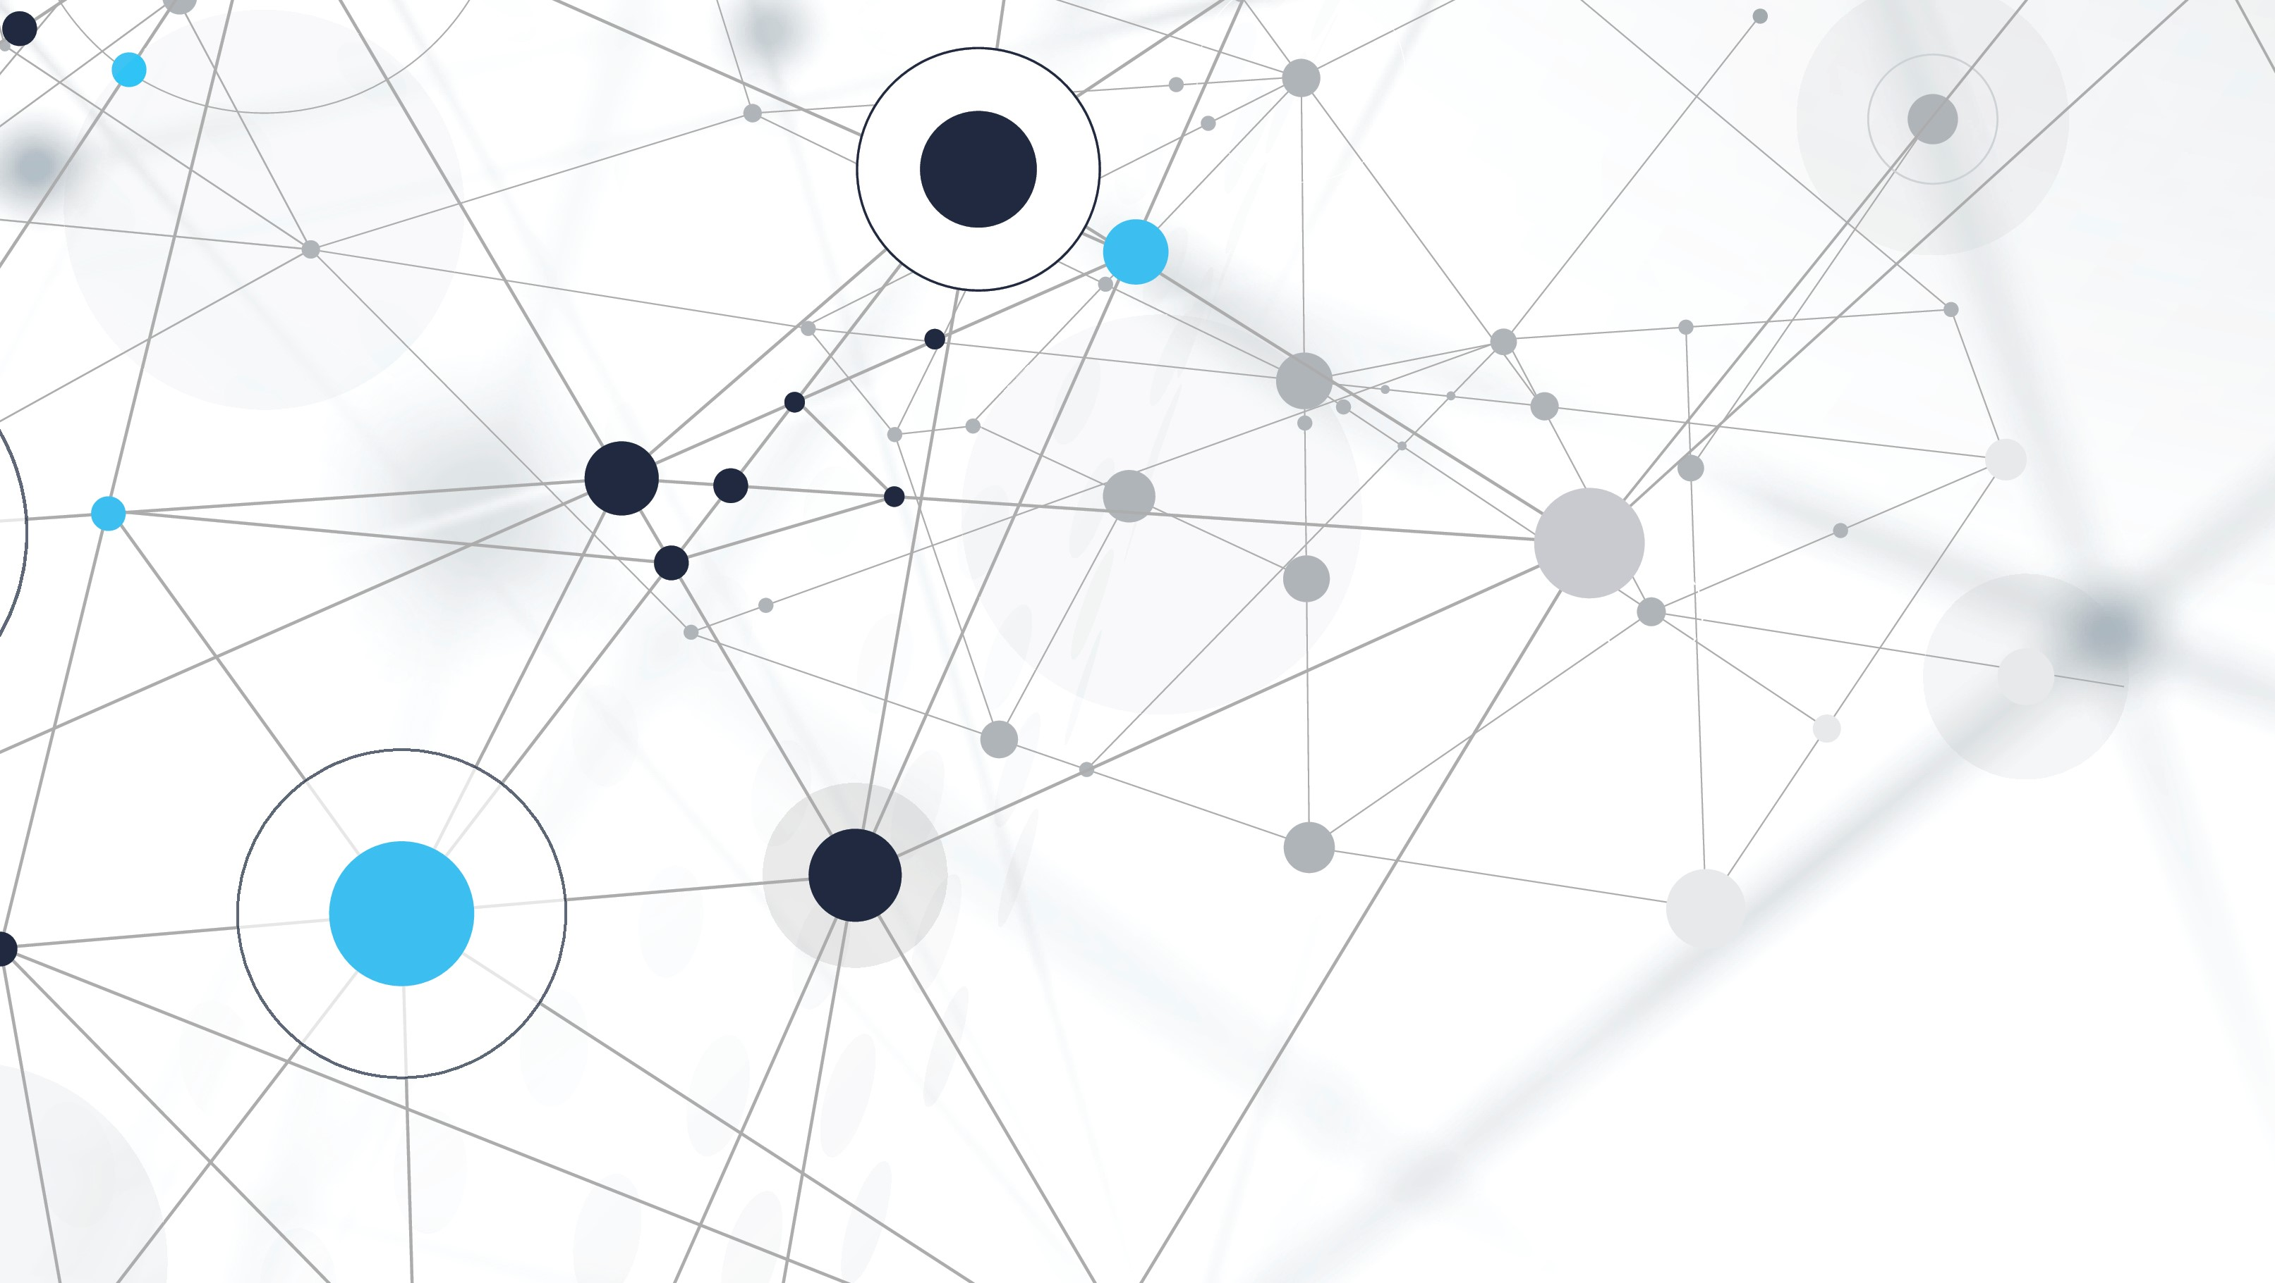
Iot Monitor
Daniel Cook

Slide 2
The Problem
Lots of devices
Lots of set up
No easy way to monitor all of them

Slide 3
Design Goals
Log data from a lot of devices
Easy to set up
Easy to access
Easy to understand

Slide 4
Requirements
Users must have separate accounts
Accounts must be secure
Users can specify any data schema for their devices
Devices can submit data independently
Users can view data in visualizations
Display trends

Slide 5
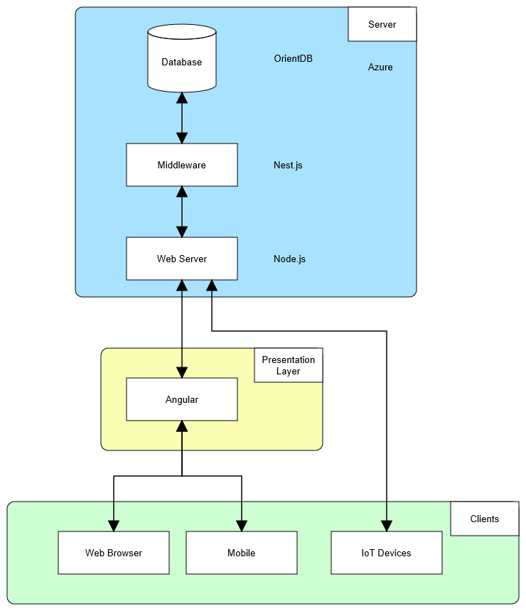
Design Concept
Back End Technologies:
OrientDB
Nest.js
Node.js
Front End Technologies:
Angular
Hosting:
Azure

Slide 6
Demo
https://iotsummerpracticum.z5.web.core.windows.net/

Slide 7
Repositories
Back End
https://github.com/dmc3152/iot-be
Front End
https://github.com/dmc3152/iot-ui
Practicum
https://github.com/dmc3152/summer-practicum

